Slide 1
Ventricular Arrhythmias (abnormal heart beat) is subdivided into:
Premature Ventricular Complex (PVC): Non-life threatening (very common)
Definition: QRS complex > 0.12 seconds
2. Ventricular Tachycardia (VT): > 3 PVC occurring & HR > 300 bpm
Non-Sustained VT: terminates in < 30 seconds
Sustained VT: sustained fro > 30 seconds
Monomorphic: similar morphology
Polymorphic: differ in morphology
Torsades de Pointes (TdP): Tachycardia with prolonged QT syndrome
3. Ventricular Fibrillation: uncoordinated contraction of the ventricles
HR > 300 bpm
Result of Ventricular Arrhythmias: Cardiac Arrest
1. Cardiac arrest: unexpected loss of cardiac function
2. Sudden cardiac arrest: Cardiac arrest NOT successfully resuscitated within 1 hr
V.fib or V.tach is responsible for 80% of Sudden cardiac Arrest
How to Treat Cardiac Arrest:
CPR
Defib

Slide 2
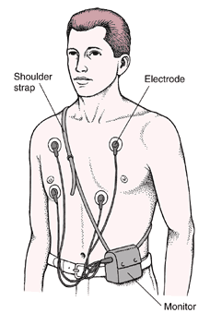
Diagnosis
Holter Monitoring:
Invasive electrophysiology study (EPS): Attempt to reproduce patient into getting a Ventricular arrhythmia.
Pros: use if arrhythmia is not detectable with short term monitoring
Cons: Must be inducible. use in control setting, d/c all antiarrhythmic drugs

Slide 3
PVC Treatment
No heart disease
Hx MI
No treatment
BB

Slide 4
Acute VT Treatment
Monitor:
EKG
Oxygen, BP, HR
Unstable?
SBP < 90
Shock
HF
Stable
Unstable
Torsades
EKG < 0.12
(normal)
EKG > 0.12
DCC
+
Mg sulfate
1 g/10 mL D5W IV
Over 10 min
Vagal Maneuvers
Else
BB or CCB
Adenosine 6 mg IV push
Else
Amiodarone 150 mg/10min
DCC
Else
Amiodarone

Slide 5
Cause of Torsades
Medications
Type 1A antiarrhythmics: Quinidine, procainamide
Type III antiarrhythmics: sotalol, dofetilide, ibutilide
-Mycins: Clarithromycin, Erythromycin
antipsychotic: Chlorpromazine, Haloperidol (also seizures)
Moxifloxacin
Opioid: Methadone

Slide 6
NSVT + s/p MI Treatment
LVEF > 35%
LVEF < 35%
BB
Else
Add amiodarone
EPS
Inducible
Noninducible
if ST elevation > 48 days: ICD
Else
Add amiodarone
BB
or
Amiodarone
If LVEF < 35% then ICD b/c if BB, the heart will pump even less. less LVEF = more problems
Notes:
Invasive electrophysiology study (EPS)
Automatic Implantable Cardioverter-Defibrillator (AICD)

Slide 7
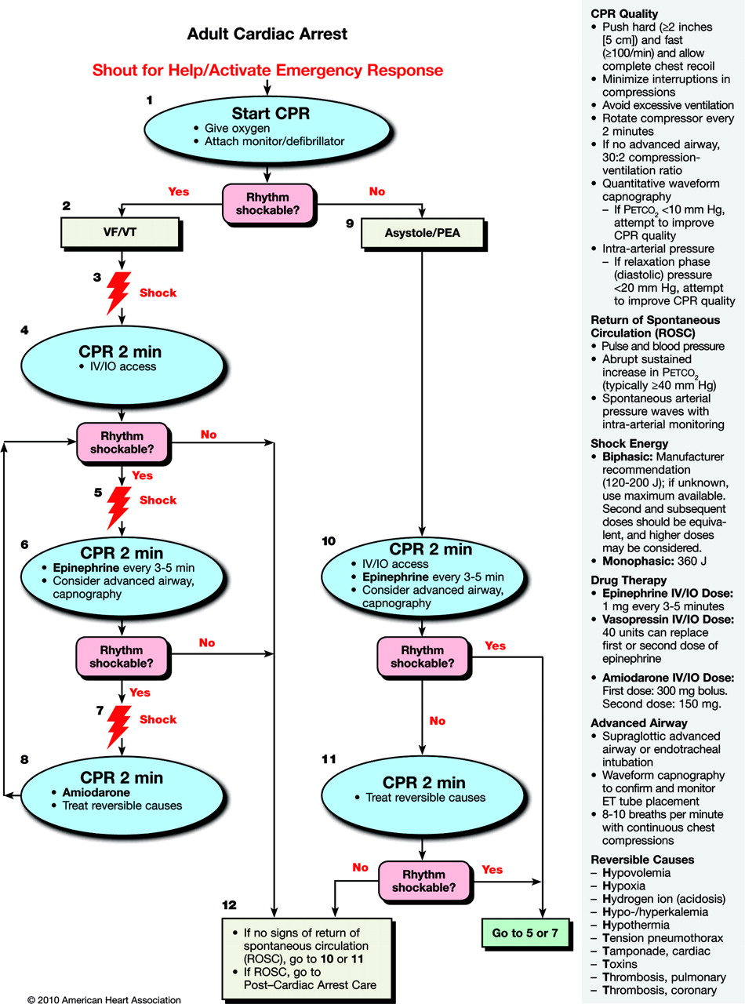

Slide 8
Reversible Causes of arrest H’s and T’s
Hypovolemia-administer fluids; bleeding-transfuse
Hypoxia-assess cpr resuscitation, oxygenation, ventilation; ET tube placement
Acidosis-asess cpr quality & ET tube; hyperventilate the patient; bicarb if <7.20
Hyperkalemia-calcium chloride, glucose+insulin, sodium bicarbonate, albuterol
Hypothermia
Tension pneumothorax-needle decompression followed by chest tube
Tamponade, cardiac (compression of the heart from fluid)echo,
pericardiocentesis (removing fluid from pericardium)
Toxins-drug overdose
Thrombosis-Pulmonary-consider thrombolytics
Thrombosis-Cardiac-lytics, cardiac cath

Slide 9
Access for Administration of Drug
Peripheral IV
Central IV
Intraosseous (IO)
Endotracheal tube (ET):
Drugs that can be administered: NAVAL
N: naloxone
A: atropine
V: Valium, Vasopressin
A: Atropine (removed from cardiac arrest algorithm)
L: Lidocaine

